Slide 1

Department of Computer Engineering
Multiplexer
Part I
1

Slide 2
Department Vision & Mission
Department of Computer Engineering
Vision
Achieve academic excellence through education in computing, to create intellectual manpower to explore professional, higher educational and social opportunities.
Mission
To impart learning by educating students with conceptual knowledge and hands on practices using modern tools, FOSS technologies and competency skills there by igniting the young minds for innovative thinking, professional expertise and research.
2

Slide 3
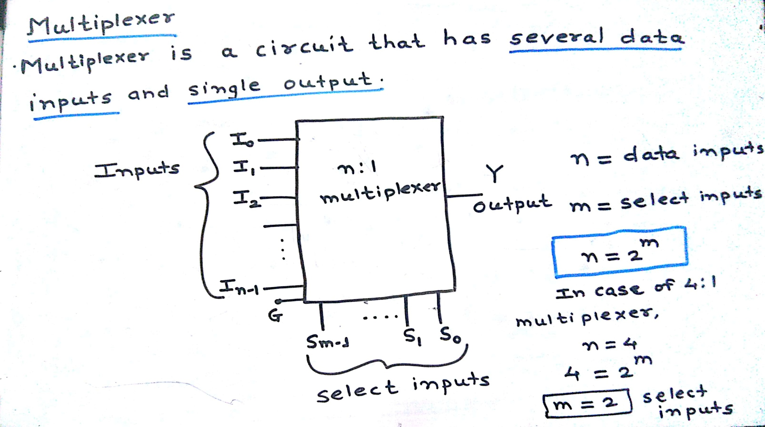
Department of Computer Engineering
Introduction

Slide 4
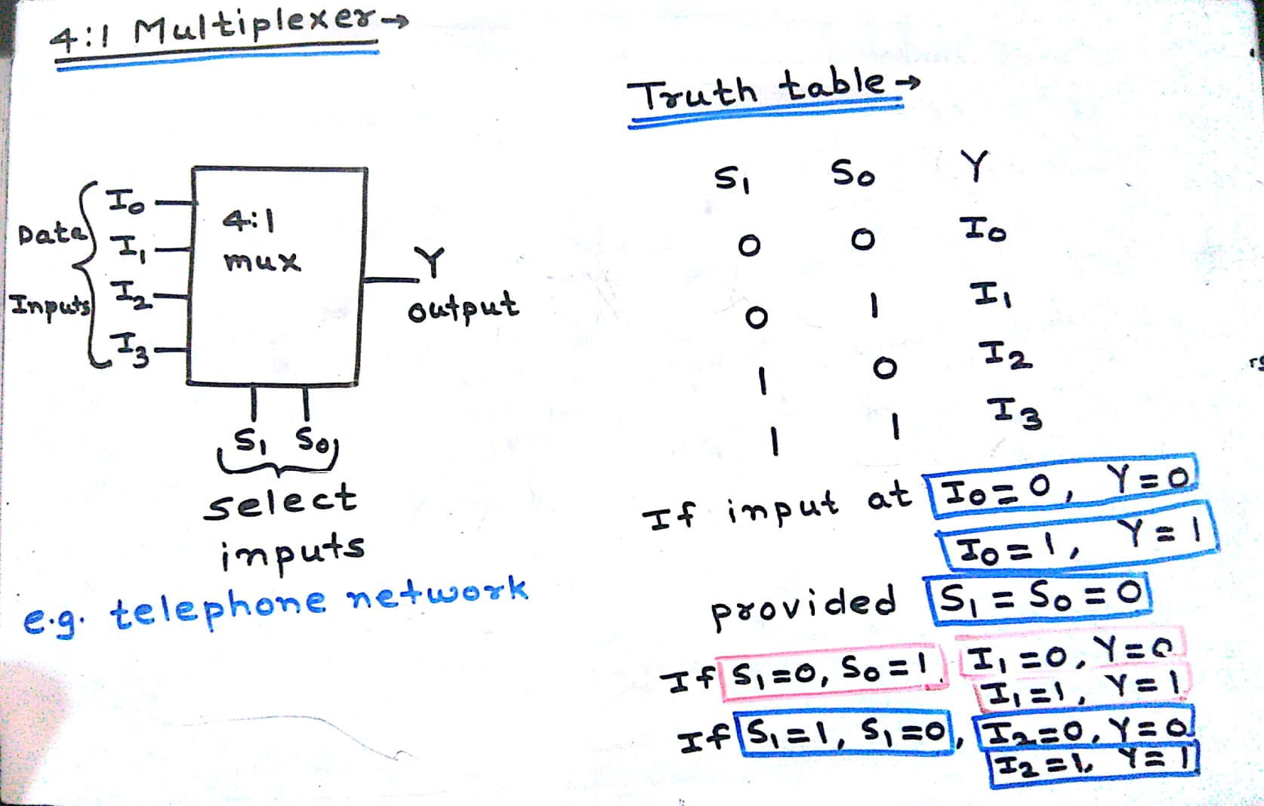
4:1 multiplexer
Department of Computer Engineering

Slide 5
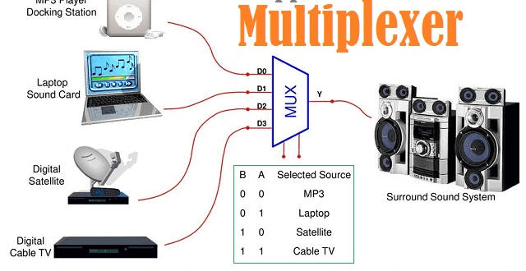
4:1 multiplexer
Department of Computer Engineering

Slide 6
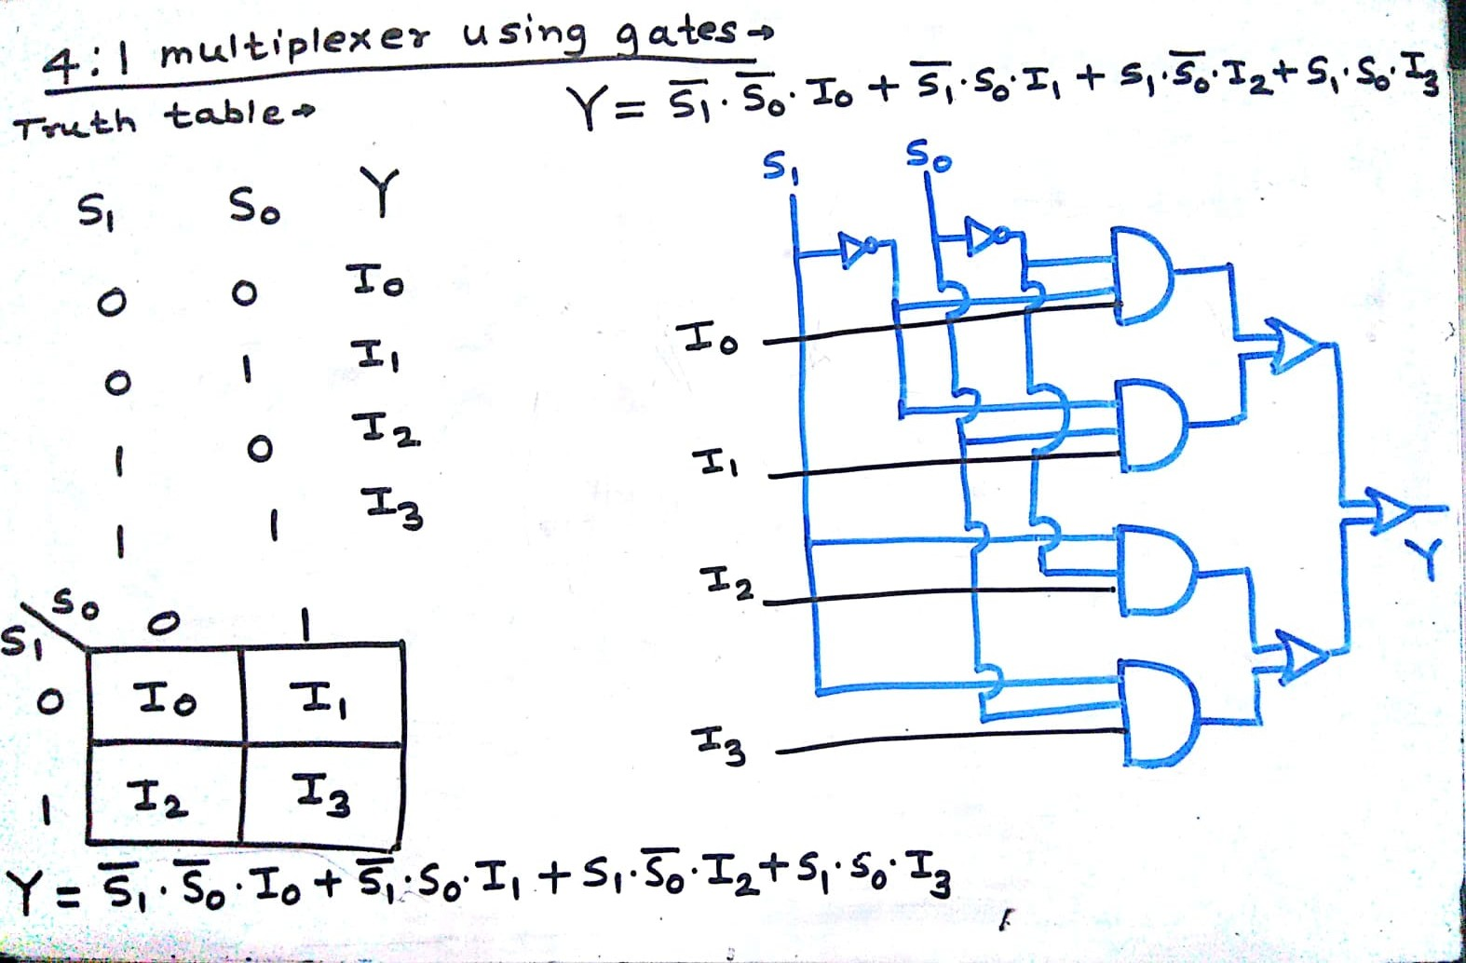
4:1 multiplexer using gates
Department of Computer Engineering

Slide 7
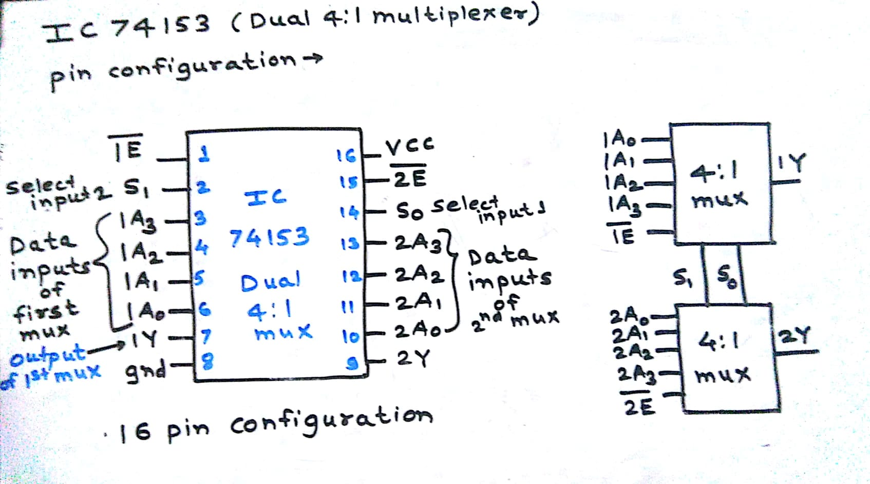
IC 74153 (Dual 4:1 multiplexer)
Department of Computer Engineering

Slide 8
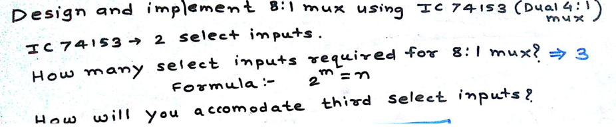
Department of Computer Engineering
Problems

Slide 9
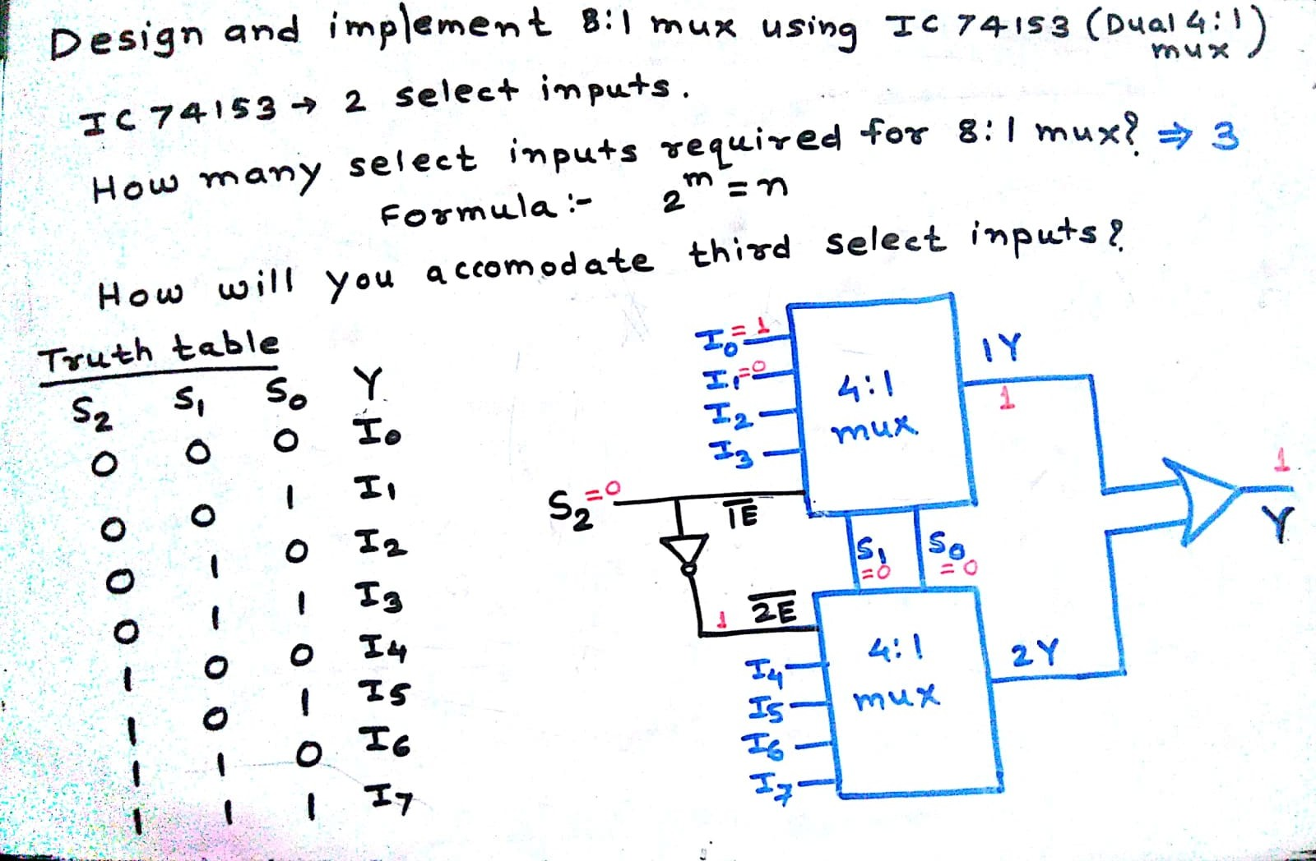
Problems
Department of Computer Engineering

Slide 10
Department of Computer Engineering
Design and implement function using 8: 1 mux
F(A,B,C)= Σ m (0,1,4,5)

Slide 11
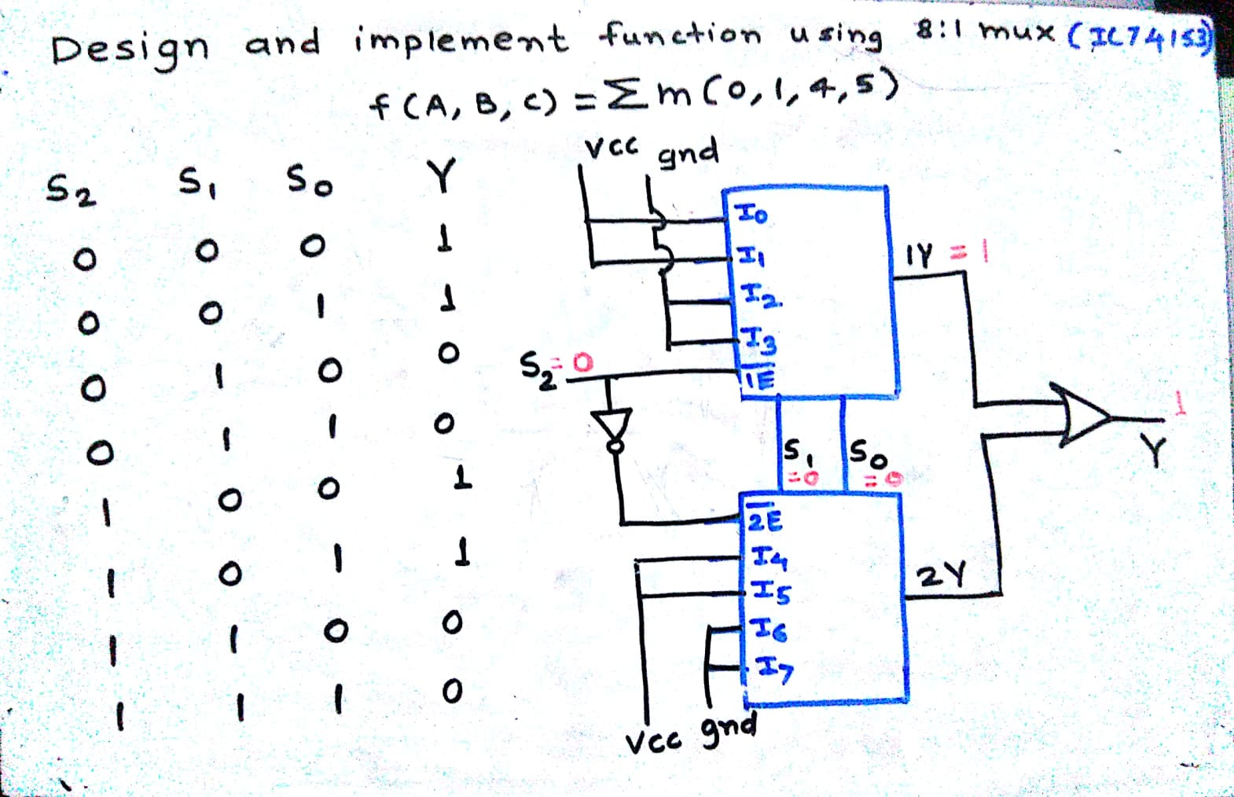
Problems
Department of Computer Engineering

Slide 12
Design full adder using 8:1 mux (IC 74153)
Sum = F(A,B,C)= Σ m (1,2,4,7)
Carry = F(A,B,C)= Σ m (3,5,6,7)

Slide 13
Department of Computer Engineering
Design and implement function using 4:1 mux
F(A,B,C)= Σ m (1, 2, 4, 7)

Slide 14
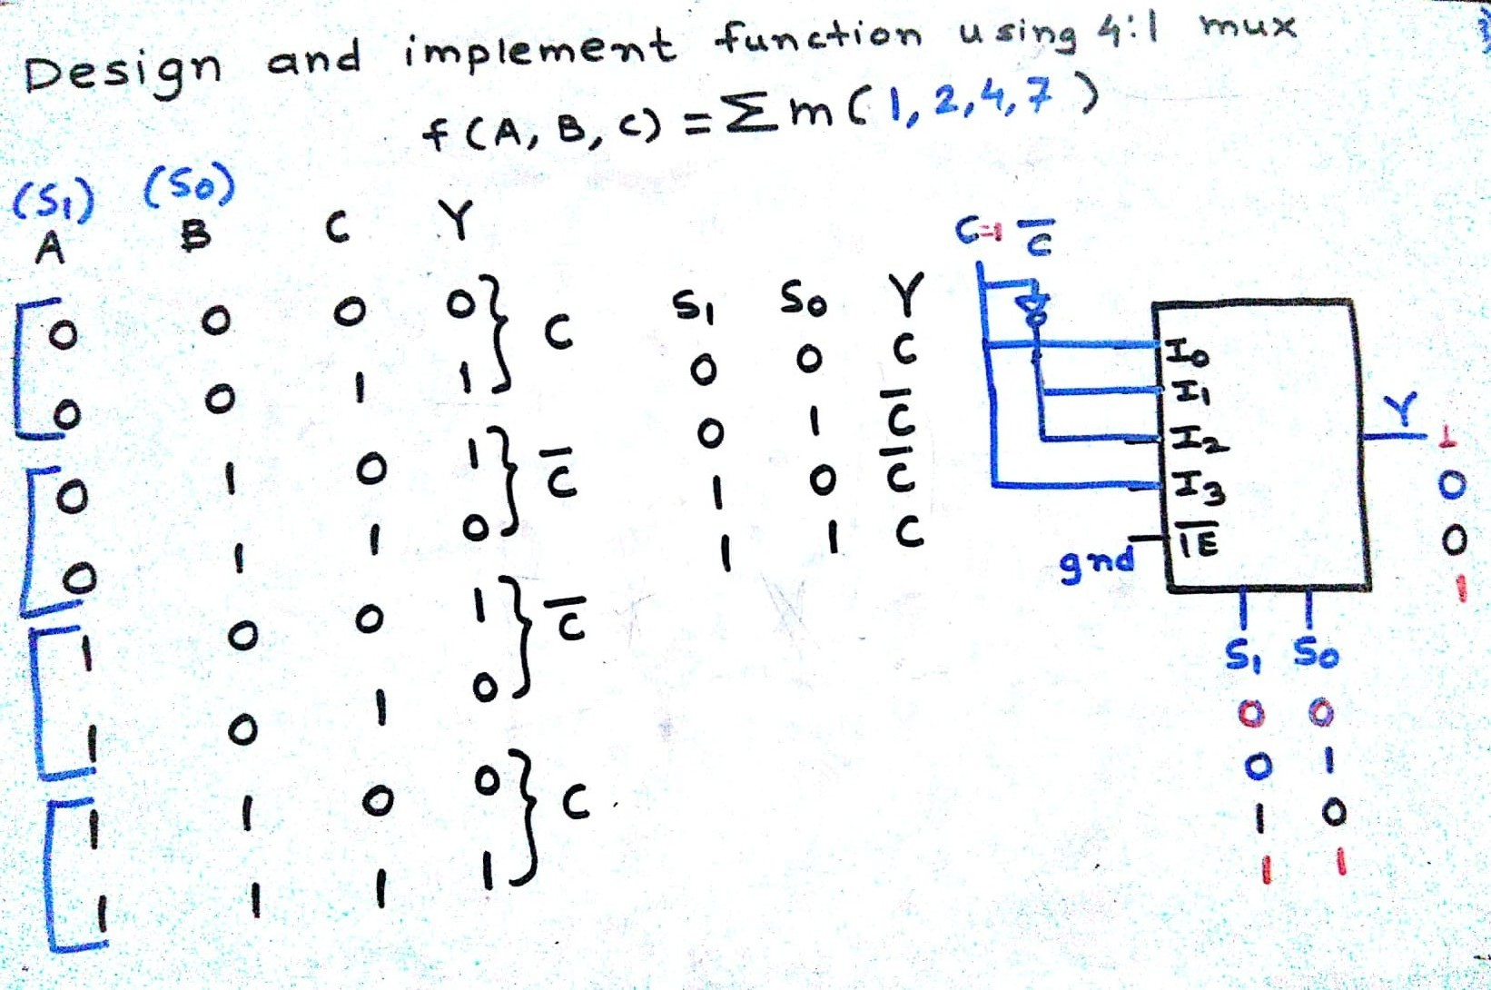
Problems
Department of Computer Engineering

Slide 16
Design full subtractor using 4: 1 mux
Difference = F(A,B,C)= Σ m (1,2,4,7)
Borrow = F(A,B,C)= Σ m (1,2,3,7)

Slide 17
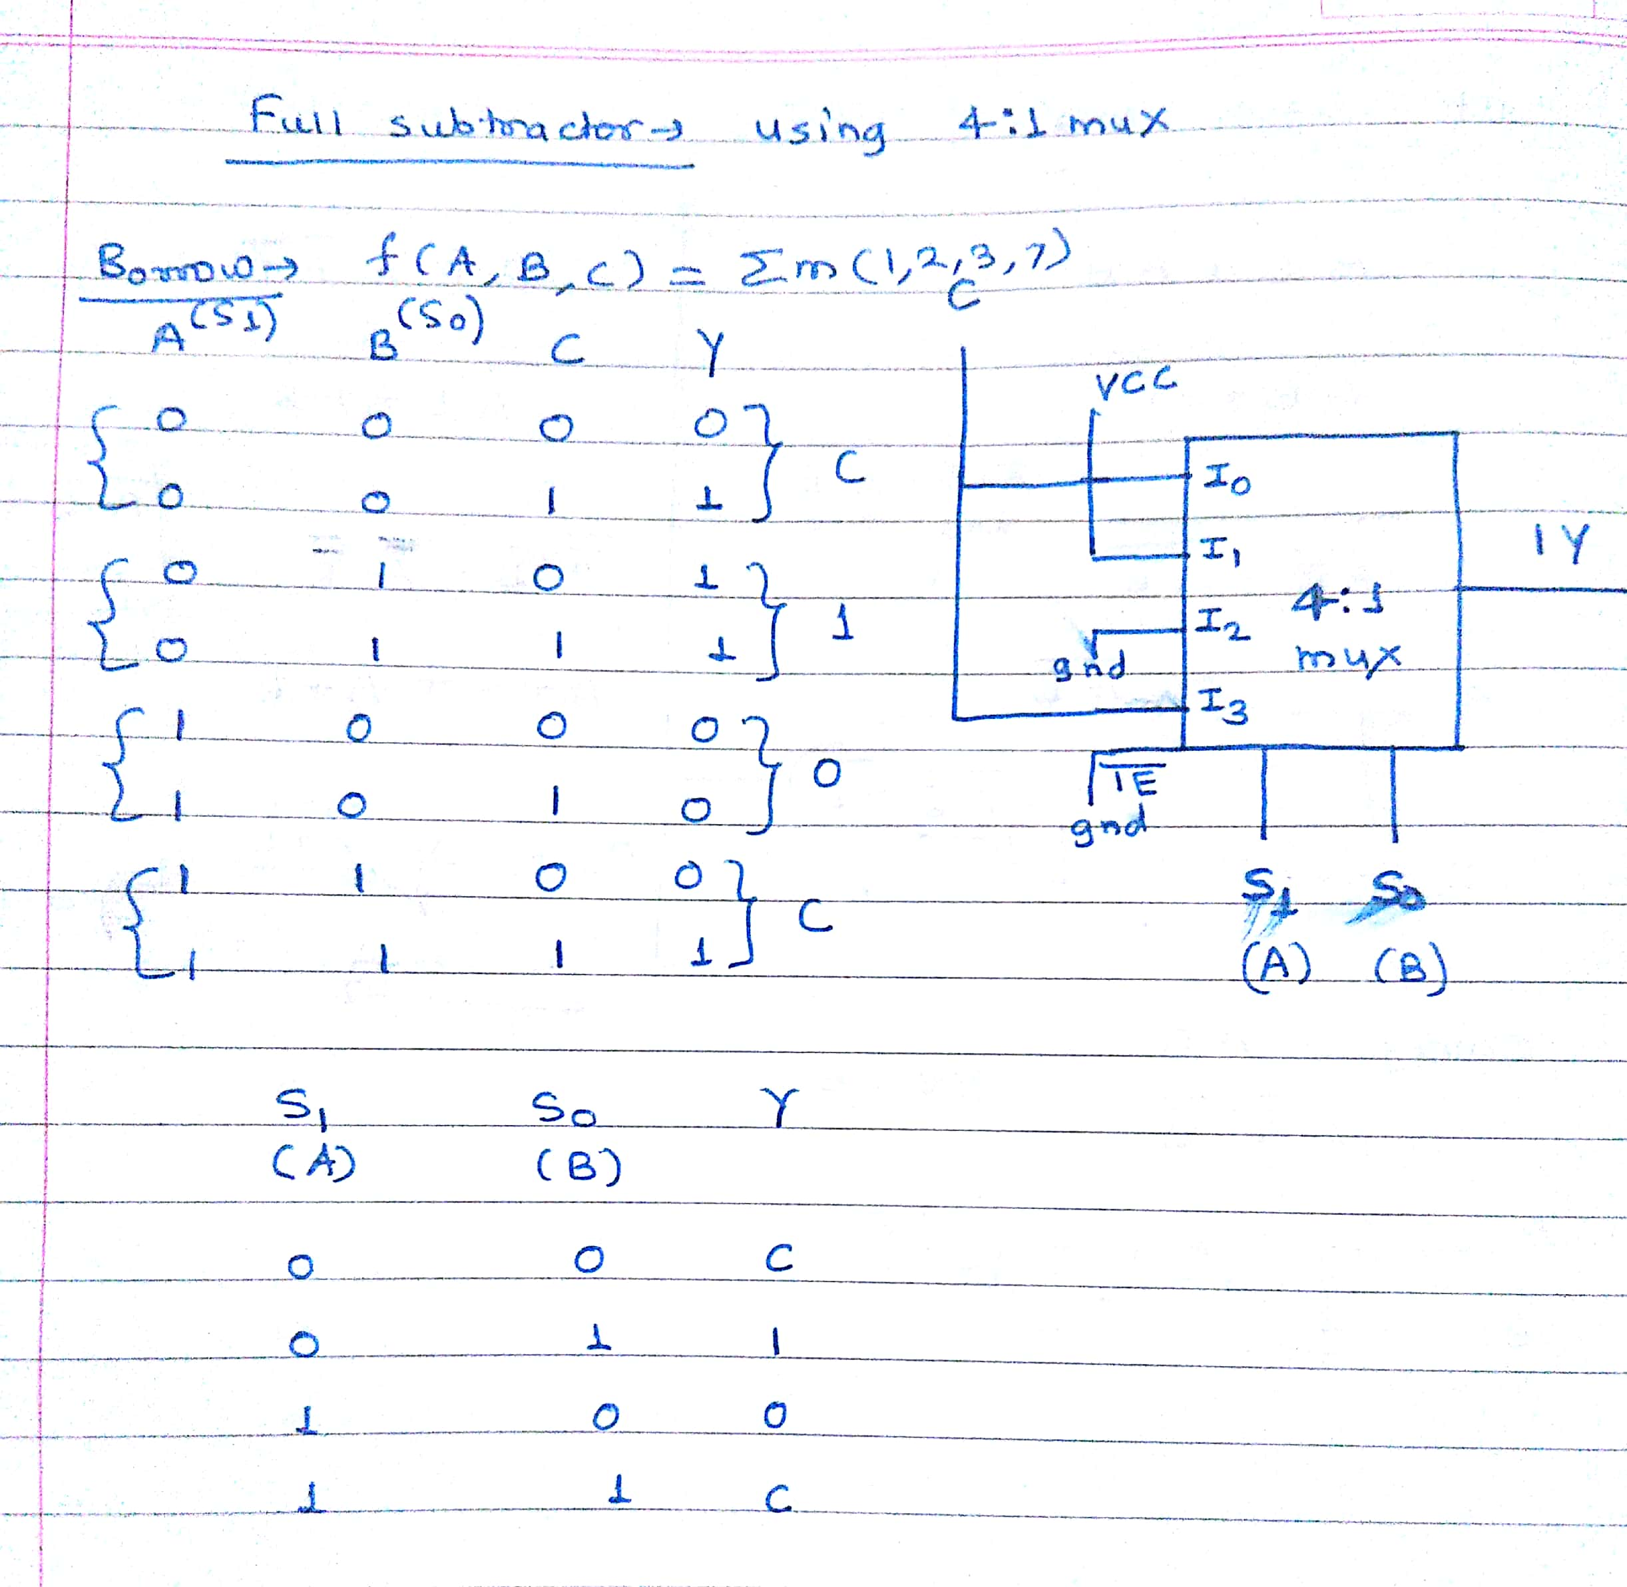

Slide 18
Quiz
Department of Computer Engineering
Please click the following link to open the quiz
https://testmoz.com/q/4219706
https://forms.office.com/Pages/ResponsePage.aspx?id=PaYKCtCCoUu5CdeYbs5MTF_APCNoJBJKm6RQWrSY69tUMjJQUDFNQTJHMVpKWjlDMEY0WENNQjFSQS4u

Slide 19
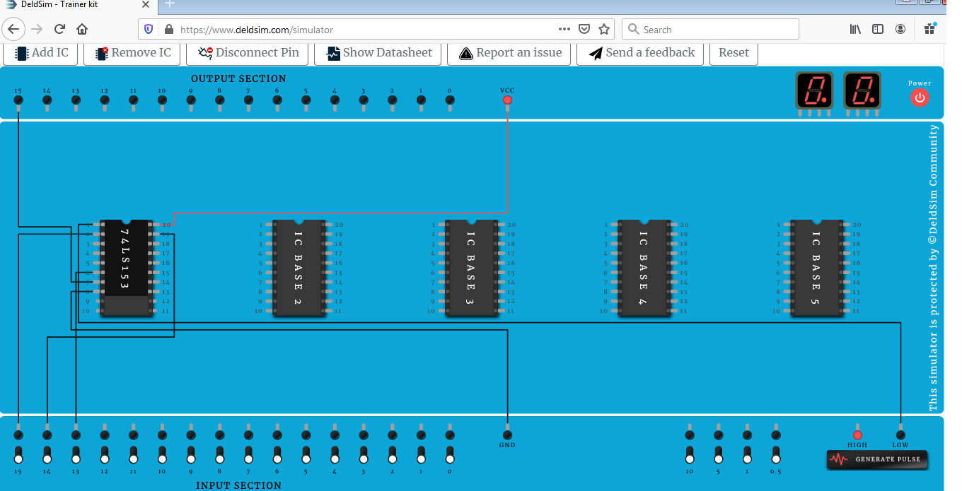
4:1 simulation IC used 74153 when input is zero

Slide 20
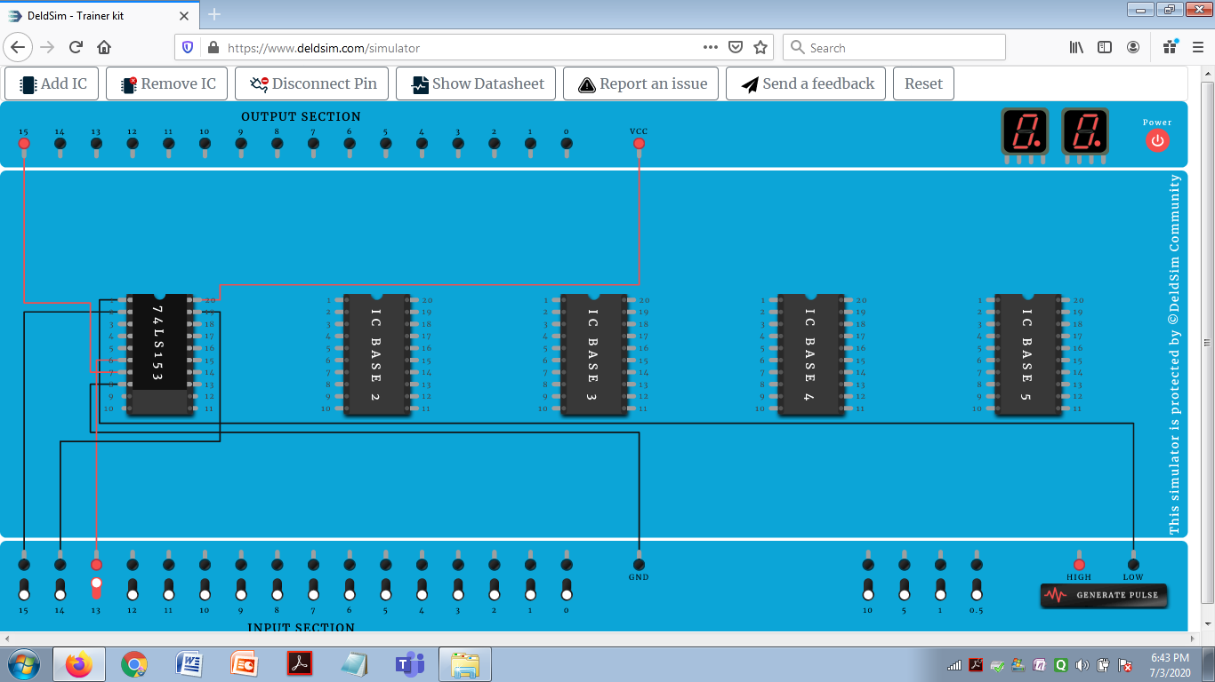
4:1 simulation IC used 74153 when input is 1

Slide 21
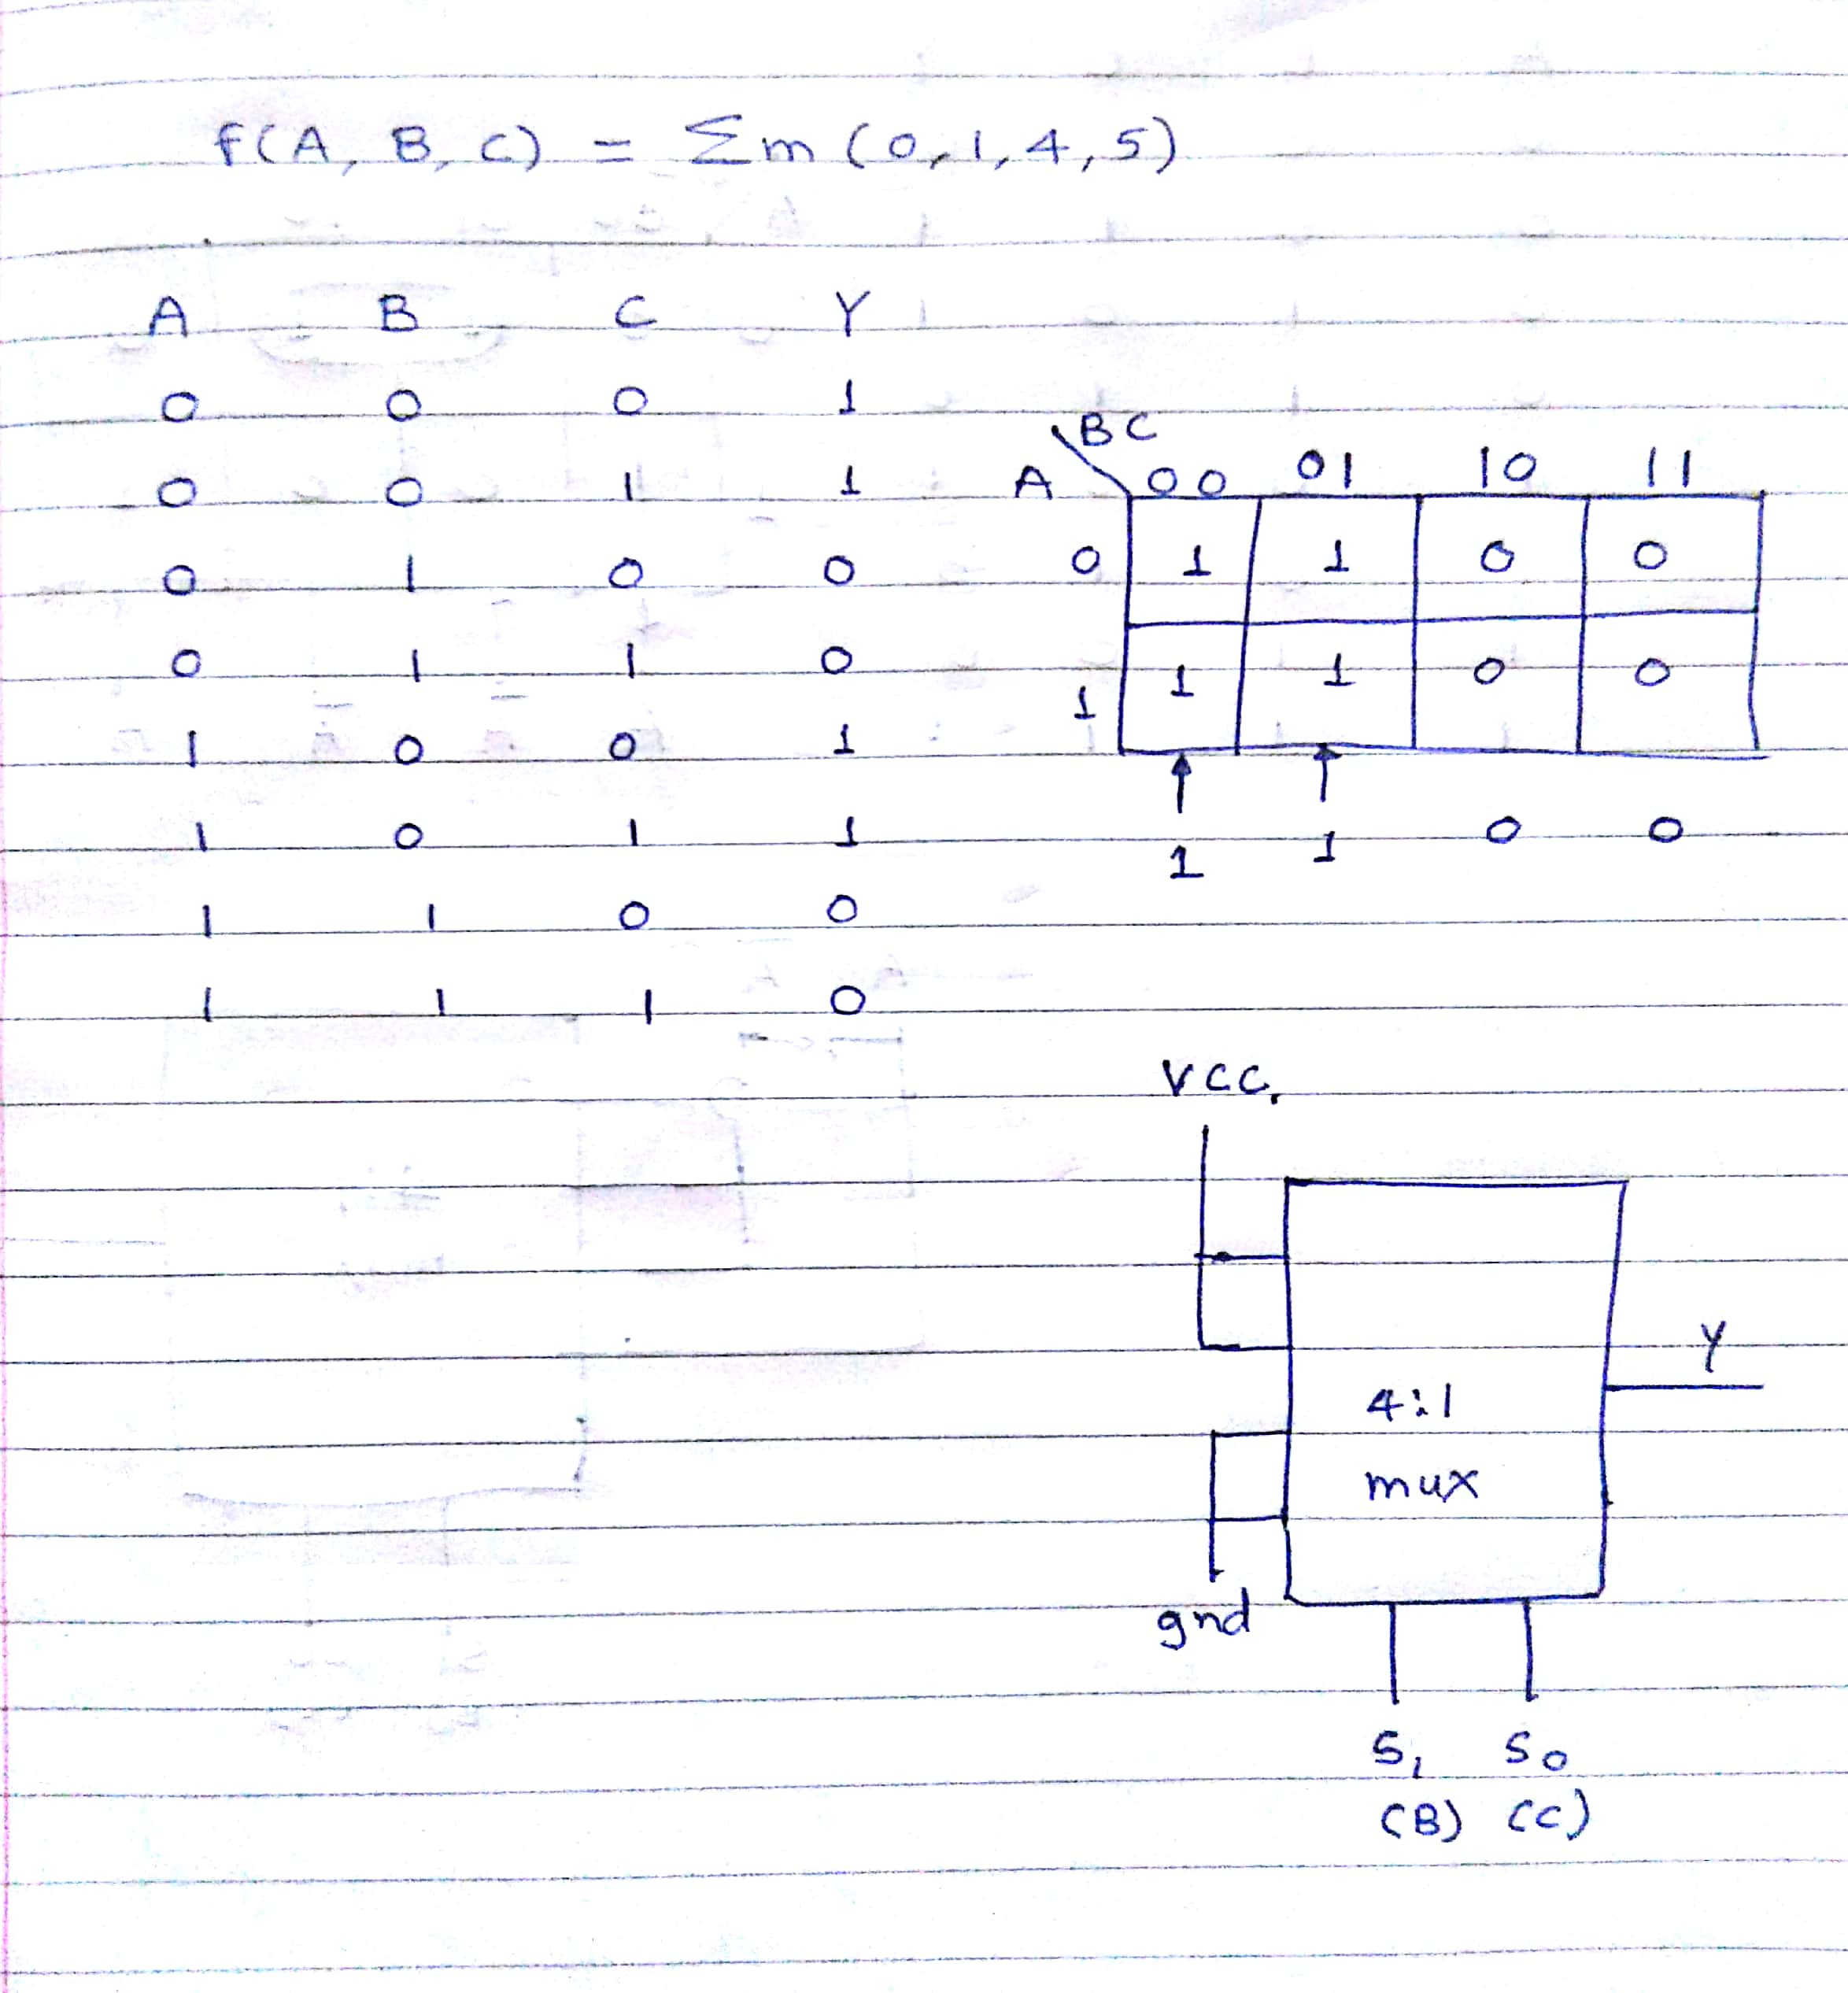

Slide 22
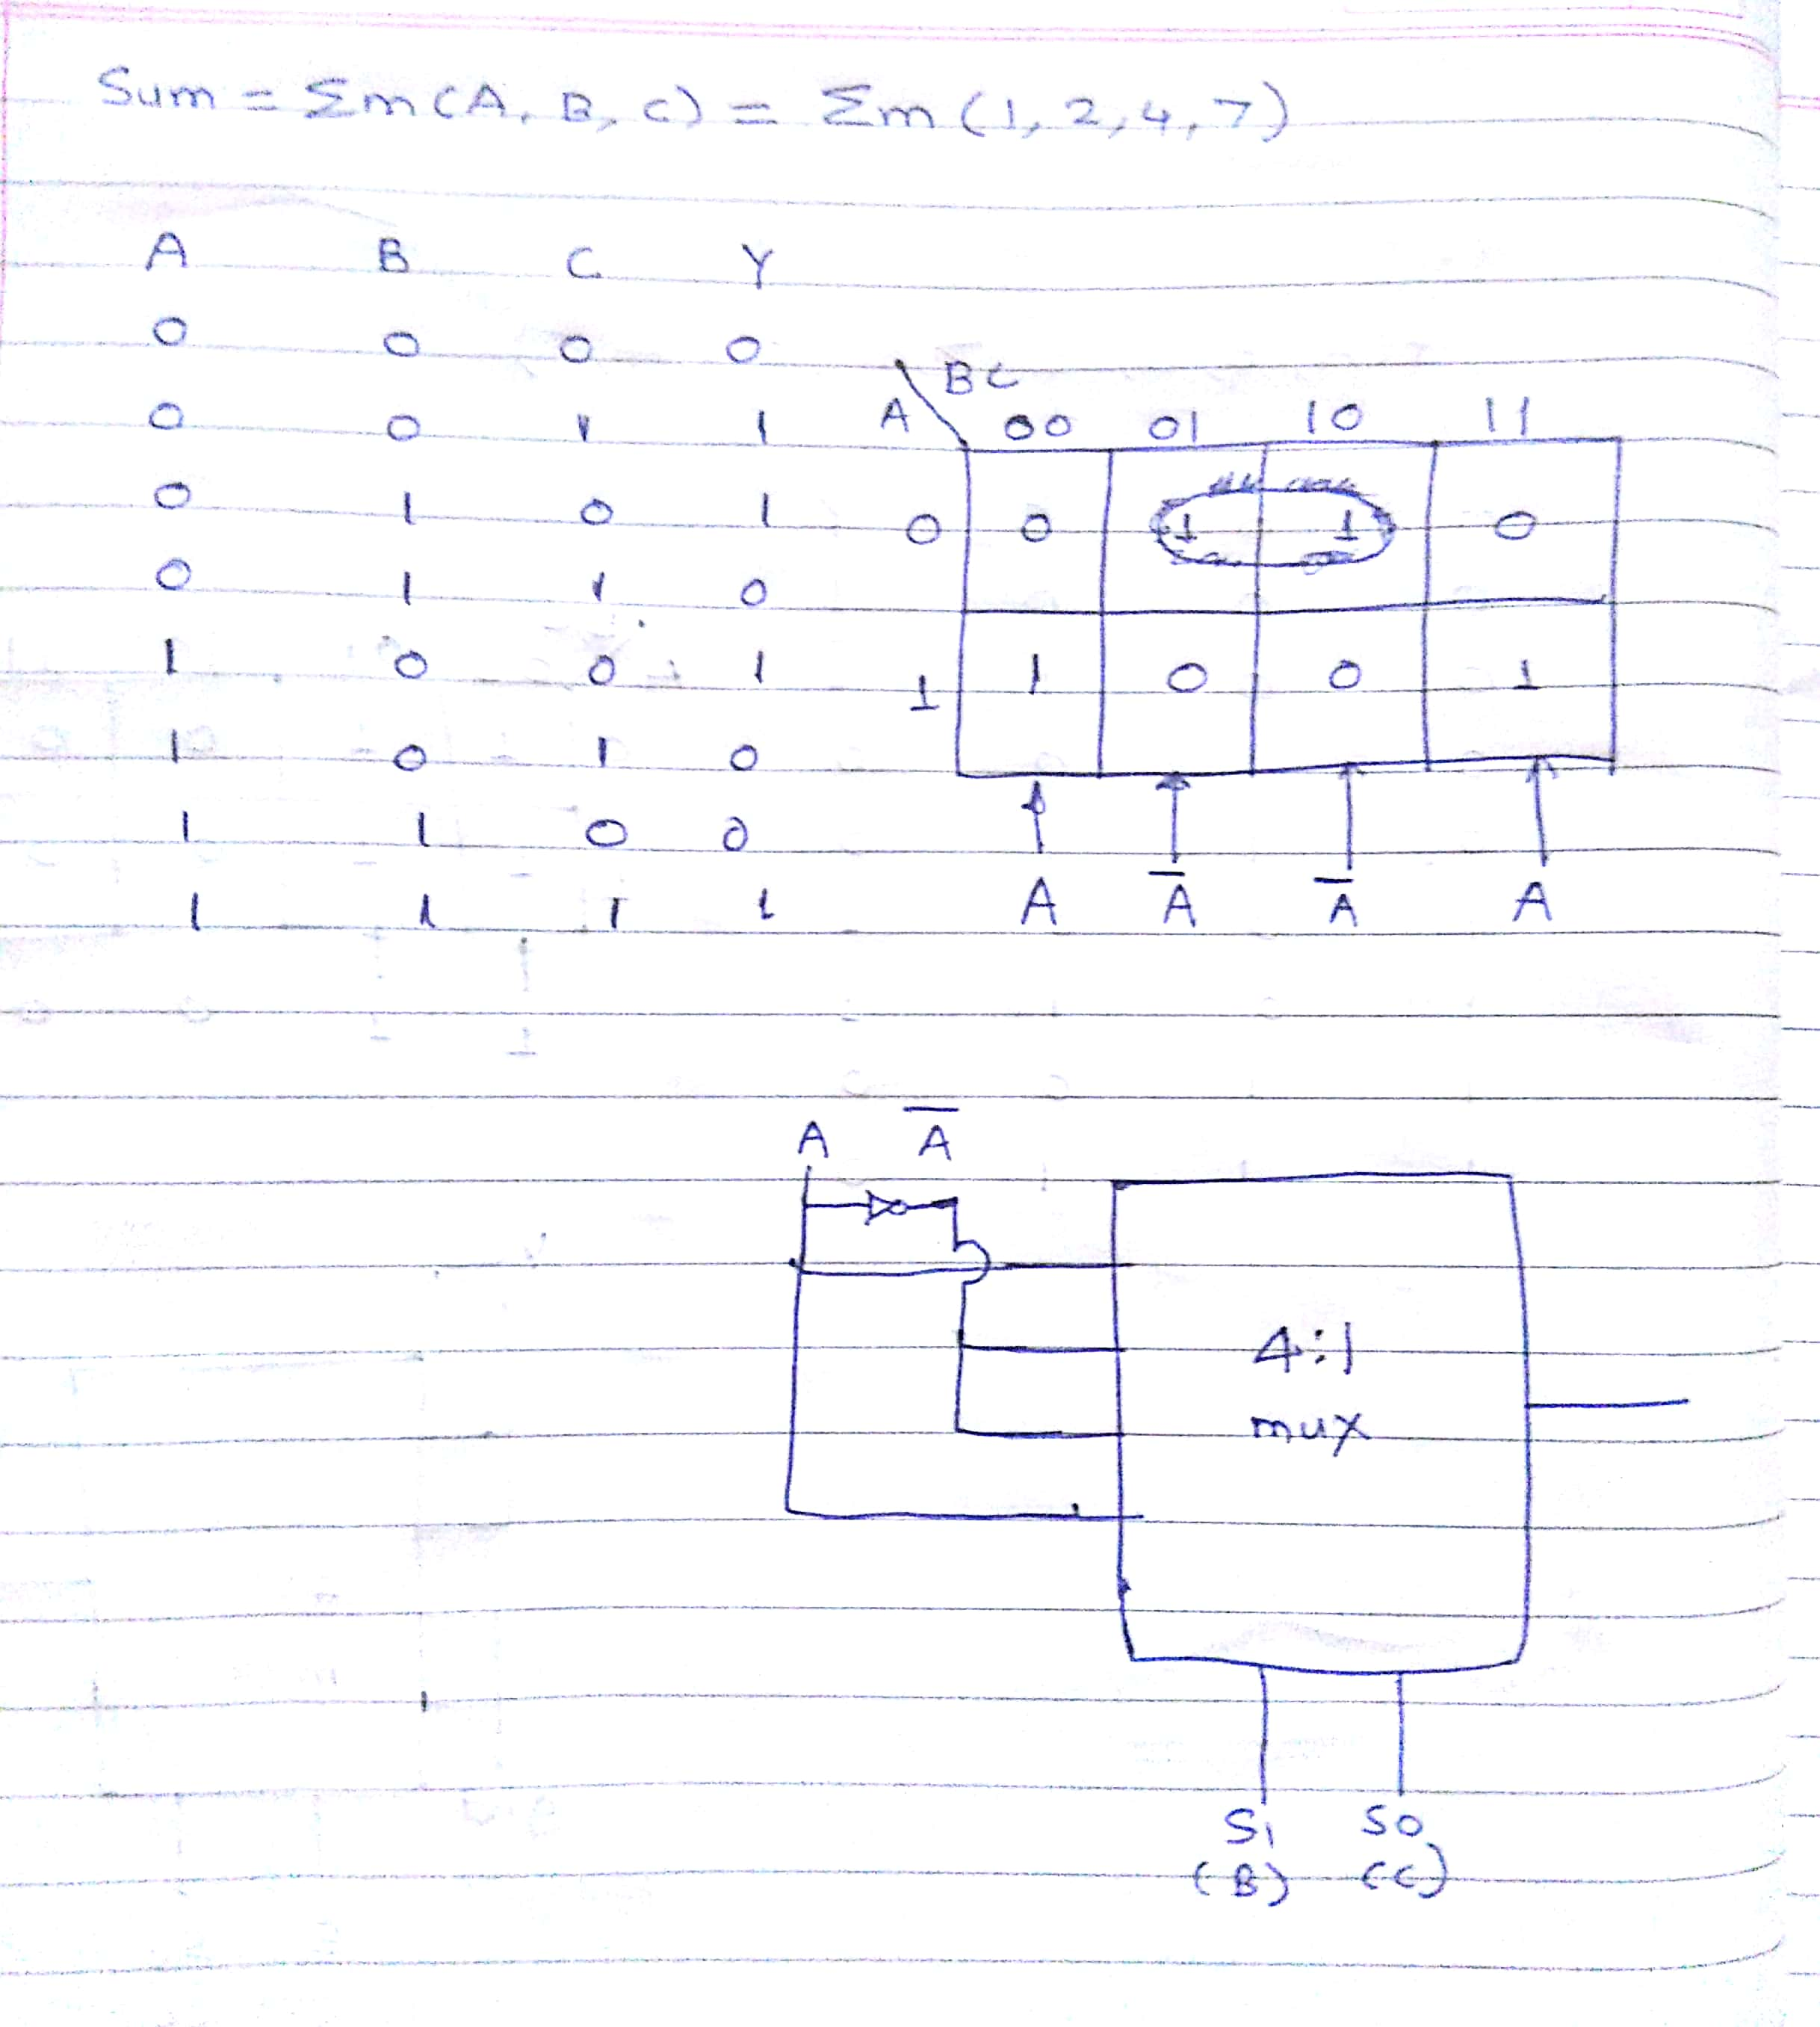

Slide 23
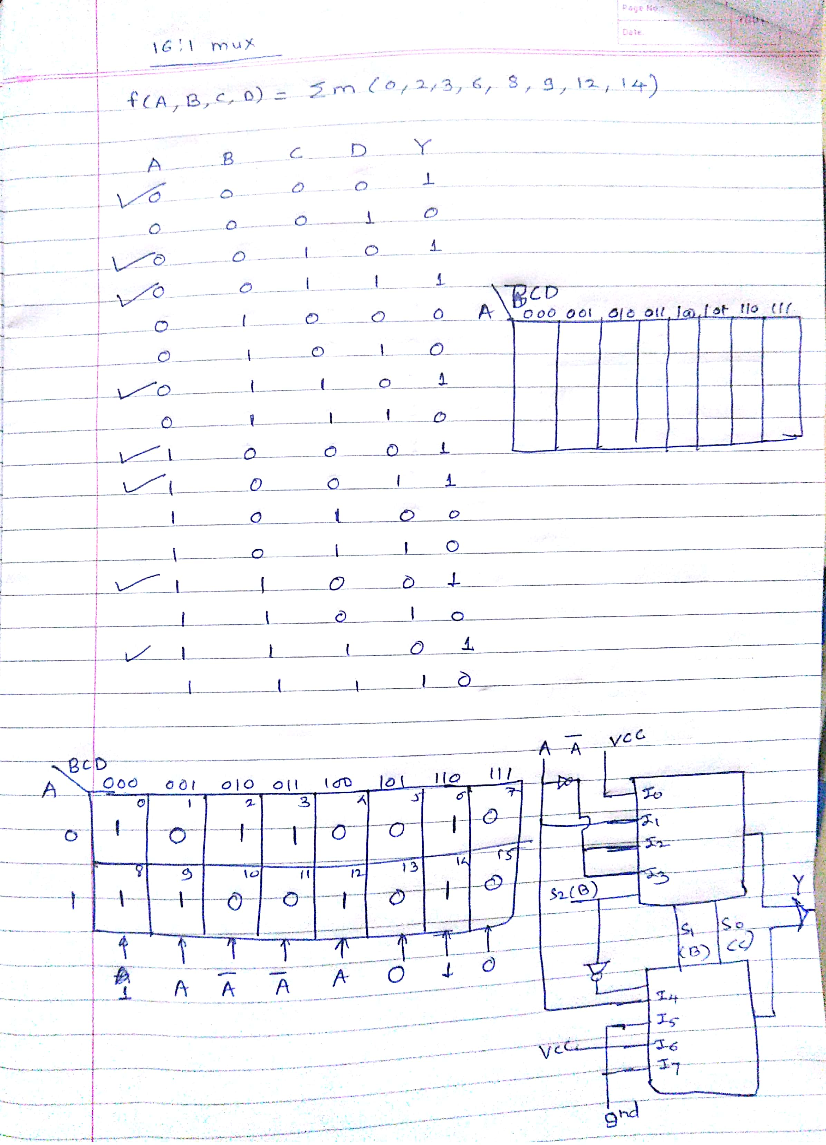

Slide 24
Summary
Department of Computer Engineering
Introduction
4:1 multiplexer
4:1 multiplexer using gates
Problems
Quiz
Demonstration using IC 74153

Slide 25
Department of Computer Engineering
Thank you

